Slide 1


Project On
TELECOM CUSTOMER CHURN ANALYSIS
By: Venkatesh V. Karnure

Slide 2
Contents
01 Color Palette
02 Business Objective
03 Data Preparation
04 Important Visuals
05 Dashboard
06 Conclusion
07 RECOMMENDATIONS

Slide 3
COLOR THEORY AND COLOR PALETTE
Color Represents The Male Ratio​
Color Represents The Female Ratio​
Color Represents The Graphs​
Color Represents The Graphs​
Color Represents the Graphs​
Color Represents the Graphs​

Slide 4
BUSINESS OBJECTIVE
Reduce Churn Among High-Risk Segments:
Prioritize retention efforts for fiber optic users with the highest churn rate (41.2%).
Promote Long-Term Contracts for Stability
Shift customers from month-to-month plans to 1–2 year contracts to reduce churn volatility.
Incentivize Low-Churn Payment Methods
Encourage automatic payments (bank transfer, credit card) to improve retention and billing consistency.
Strengthen Support & Security Features
Enhance tech support and online security offerings to increase satisfaction and reduce churn.

Slide 5
DATA PREPARATION
Steps Taken
  Imported the dataset into Power BI.
  Removed duplicates and handled missing values (mainly in Total Charges).
  Converted data types – e.g., Senior Citizen (0/1 → Yes/No).

Slide 6
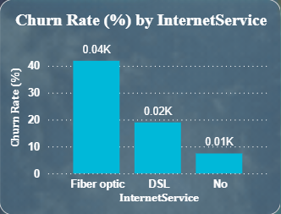
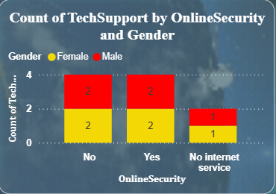
KEY VISUALS
Fiber optic users churn the most indicating a critical service dissatisfaction zone.
Lack of online security and tech support leaves both genders equally vulnerable to churn.

Slide 7
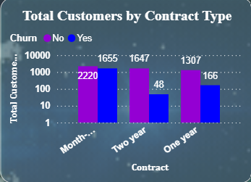
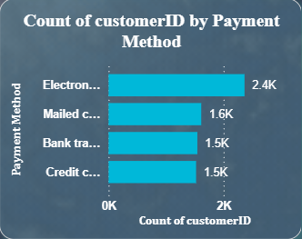
Month‑to‑month contracts drive the highest churn, while long‑term plans anchor retention.
Electronic check users churn more, whereas auto‑payment methods foster loyalty.”

Slide 8
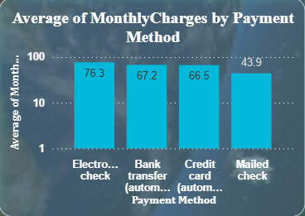
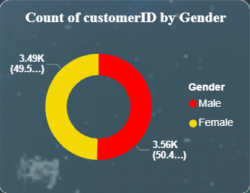
“Electronic check users pay the most, linking higher charges to higher churn risk
Male and female customers are nearly equal, showing gender has little impact on churn.”

Slide 9
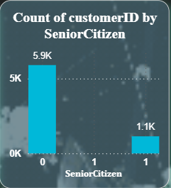
“Non‑seniors dominate the base, but seniors—though fewer—show higher churn risk.”
Tailored offers and simplified support can improve satisfaction and reduce senior churn.

Slide 10
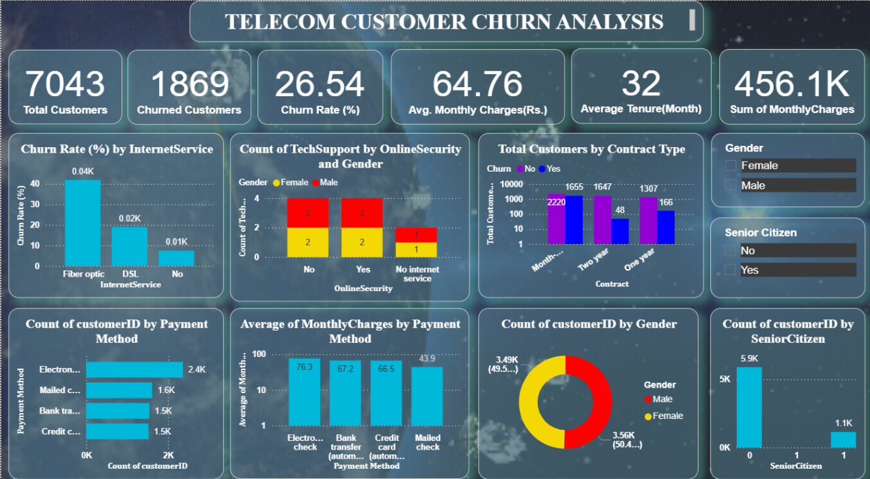
DASHBOARD

Slide 11
LINK TO THE DASHBOARD
Click For Dashboard

Slide 12
CONCLUSION
Internet Service: Fiber Optic users churn the most; DSL is moderate; no internet = lowest churn
Support Services: Lack of Online Security & Tech Support increases churn
Contract Type: Month-to-month contracts lead to higher churn; long-term contracts retain customers
Payment Method: Electronic Check users churn more; auto-pay users stay longer
Monthly Charges: Higher charges correlate with higher churn
Gender: No major impact on churn
Billing Type: Paperless billing users churn more than traditional billing users

Slide 13
RECOMMENDATIONS TO REDUCE CHURN
Target Fiber Optic Users with loyalty offers or service upgrades.
Promote Online Security & Tech Support as bundled benefits.
Encourage Long-Term Contracts with discounts or perks.
Incentivize Auto-Pay Options to reduce churn from manual payments.
Review Pricing Strategy for high-charge segments like Electronic Check users.
Support Senior Citizens with tailored plans and easy assistance.
Educate Customers on benefits of traditional billing or offer hybrid options.

Slide 14
ANY QUESTIONS..???
THANK
YOU....

